Slide 1

Pyber Summary
Homework # 5
Nary Tang

Slide 2
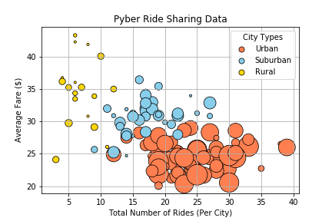
Observation #1
There is a strong correlation between the average fare ($) and the city type and number of drivers per city.
*Size of bubbles represent the number of drivers/city

Slide 3

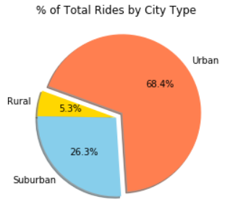
Observation #2
There are more rides in Urban cities than Suburban and Rural cities combined.

Slide 4
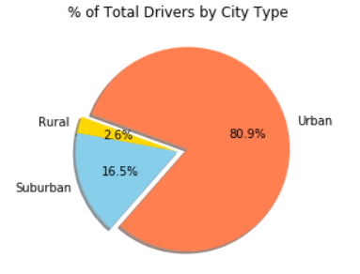
Observation #3
Urban cities, unlike Suburban and Rural cities, have more drivers available per ride.

